Slide 1

Advanced Machine Learning Techniques
Session - 2

Slide 2
Advanced MLT – Course overview
Dimensionality reduction
Principal Component Analysis
Linear Discriminant Analysis , Locally Linear Embedding
T - Distributed Stochastic Neighbour Embedding
Clustering and Mixture models
Machine Learning Project Life Cycle
ML deployment
Deployment using FastAPI and cloud platforms

Slide 3

Dimensionality Reduction

Slide 4
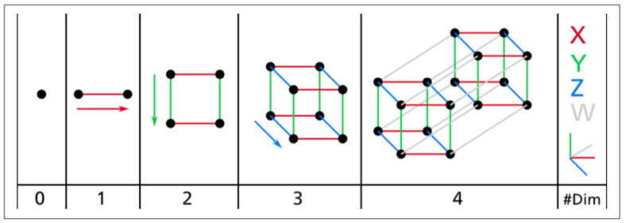
Increasing dimension

Slide 5
Increasing dimension => Curse of dimensionality
Dim | Points | Distance
1 | 1,5 | 4
2 | (1,1), (5,5) | 5.66
3 | (1,1,1), (5,5,5) | 6.93
4 | (1,1,1,1), (5,5,5,5) | 8
5 | (1,1,1,1,1), (5,5,5,5,5) | 8.94

Slide 6
Issues with high dimensionality
Overfitting models
Not enough training set

Slide 7
Approaches to dimensionality reduction
Projection
Manifold Learning

Slide 8
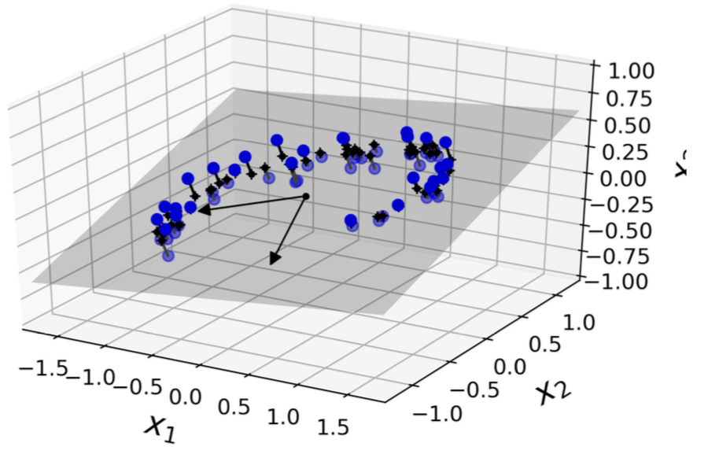
Projection

Slide 9
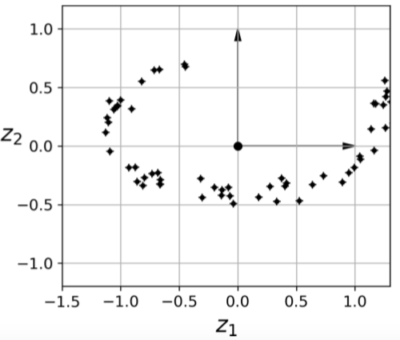
Projection
Results in info loss

Slide 10

Issue with projection: Eg swiss roll

Slide 11
Issue with projection: Eg swiss roll

Slide 12
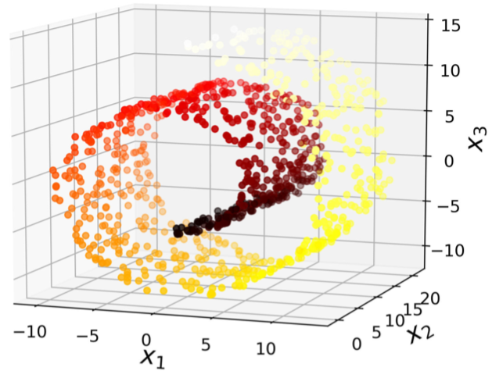
Swiss roll data set

Slide 13
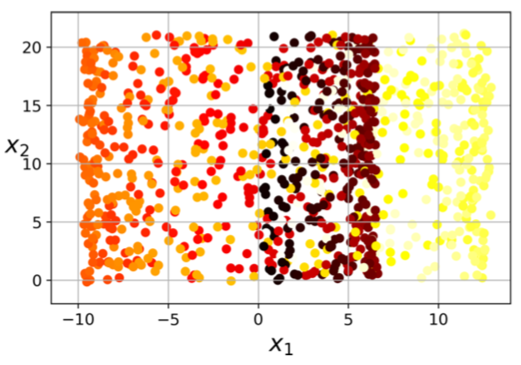
Projection of swiss roll data sets

Slide 14
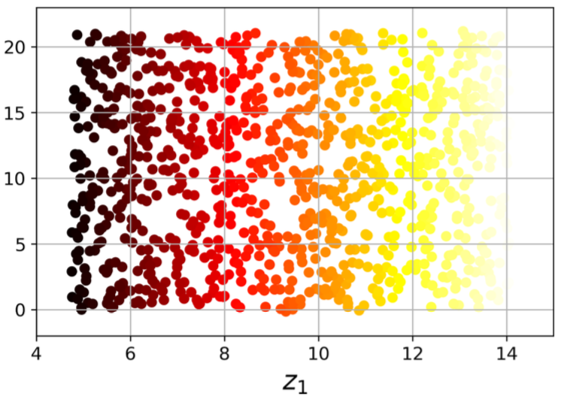
Manifold Learning: Unrolling

Slide 15
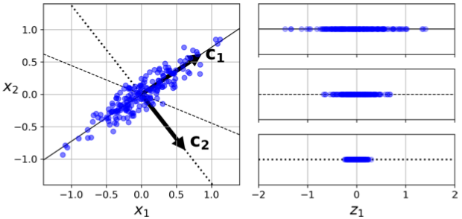
Principal Component Analysis - PCA
Identifies the right hyperplane that is closest to the data, then projects into it.
Right…?

Slide 16
Principal Component Analysis - PCA
Choose the hyperplane which preserves the maximum amount of variance.
Principal component: the axis which has this property.
For, 3D or higher, choose another axis, which is orthogonal(perpendicular) to the PC, which preserves maximum variance.

Slide 18
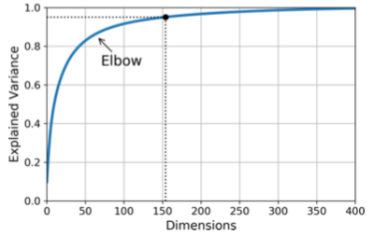
Characteristics of PCA
Explained variance ratio: Proportion of data’s variance explained by each PC
# of PC: Min of PCS required to keep around 95% of variance. Usually 2 or 3.

Slide 19
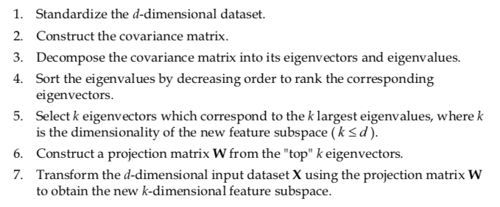
Implementation of PCA

Slide 20
Implementation of PCA

Slide 21
LDA and LLE
Linear Discriminant Analysis
PCA vs LDA
Steps involved in the process
Implementation
Locally Linear Embedding
LlE vs PCA/LDA
Steps involved in the process
Implementation

Slide 22
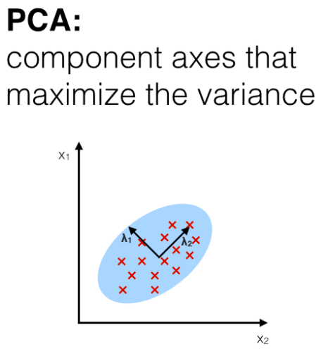
Linear Discriminant Analysis

Slide 23
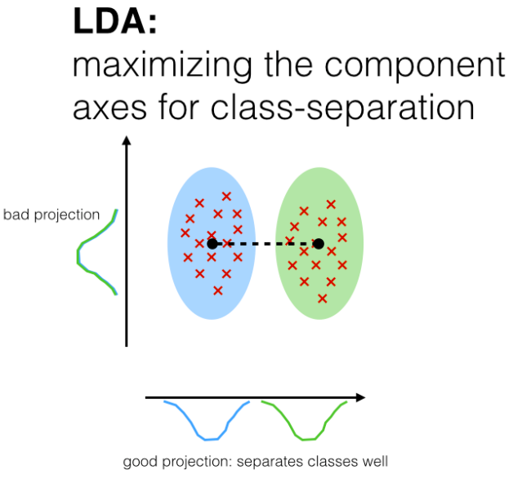
Linear Discriminant Analysis

Slide 24
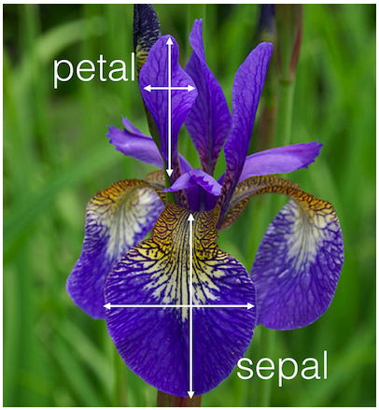
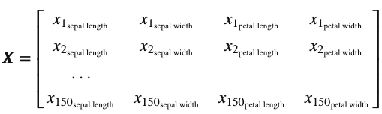
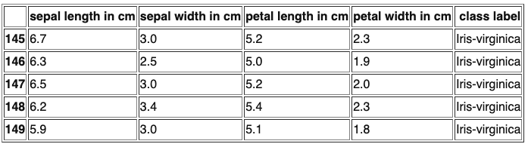
LDA: Eg.

Slide 25
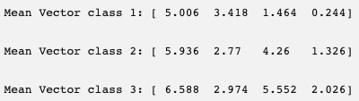
LDA Steps
1. Compute mean vector of each class.

Slide 26
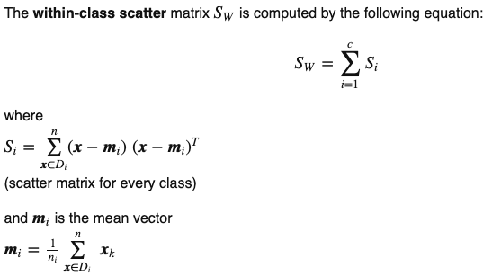
LDA Steps
1. Compute mean vector of each class.
2. Compute scatter matrices for in between and within classes.

Slide 27
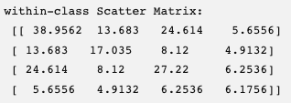
LDA Steps
1. Compute mean vector of each class.
2. Compute covariance /scatter matrices for in between and within classes.

Slide 28
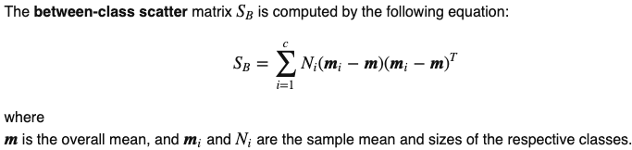
LDA Steps
1. Compute mean vector of each class.
2. Compute scatter matrices for in between and within classes.

Slide 29
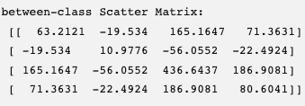
LDA Steps
1. Compute mean vector of each class.
2. Compute scatter matrices for in between and within classes.

Slide 30
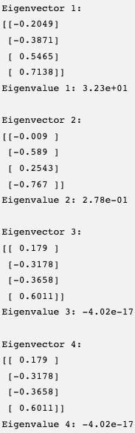
LDA Steps
1. Compute mean vector of each class.
2. Compute scatter matrices for in between and within) classes.
3. Solve matrix [Sw ^{^-1} . SB] to get eigen values and eigen vectors.

Slide 31
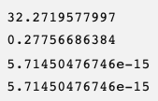
LDA Steps
1. Compute mean vector of each class.
2. Compute scatter matrices for in between and within) classes.
3. Solve matrix [Sw ^{^-1} . SB] to get eigen values and eigen vectors.
4. Sort eigen values in decreasing order and choose k eigen vectors with highest eigen values. Create W by taking those eigen vectors as columns

Slide 32
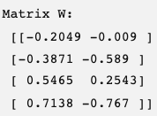
LDA Steps
1. Compute mean vector of each class of the set X..
2. Compute scatter matrices for in between and within) classes.
3. Solve matrix [Sw ^{^-1} . SB] to get eigen values and eigen vectors.
4. Sort eigen values in decreasing order and choose k eigen vectors with highest eigen values. Create W by taking those eigen vectors as columns.
Obtain Y=X.W, this is the transformed feature surface

Slide 33
Locally Linear embedding
Manifold learning
Focuses on nearby points of each data point
Distance is locally preserved.

Slide 34
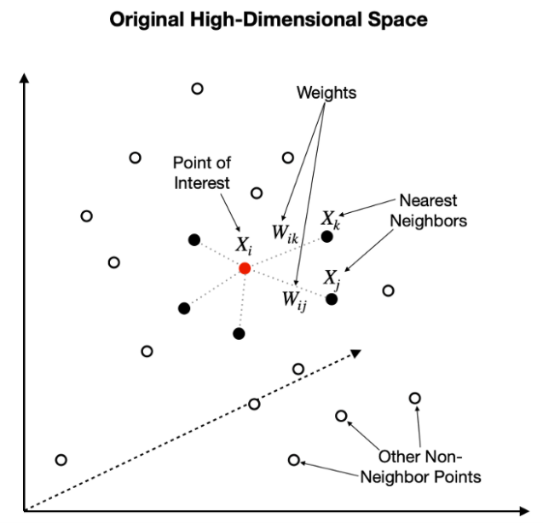
Locally Linear embedding
For each data point, identify k neighbors.
Represent this point as linear combination of its neighbors using initial random weights.
We get a weight matrix W.

Slide 35
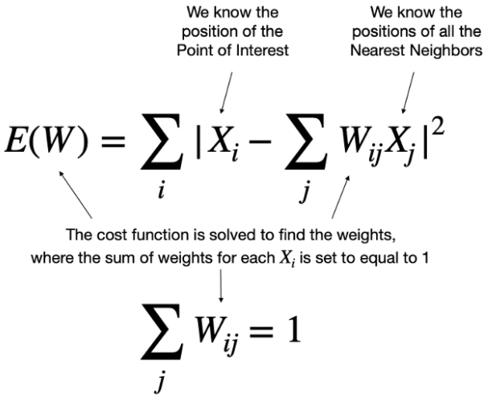
Locally Linear embedding

Slide 36
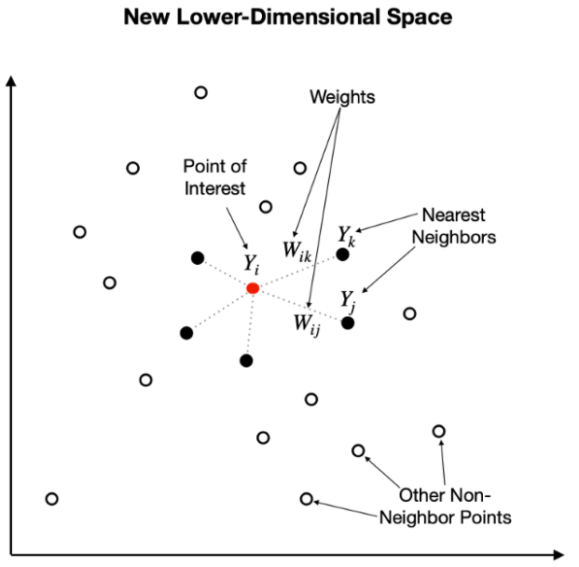
Locally Linear embedding
Map these points into lower dimensional space.

Slide 37
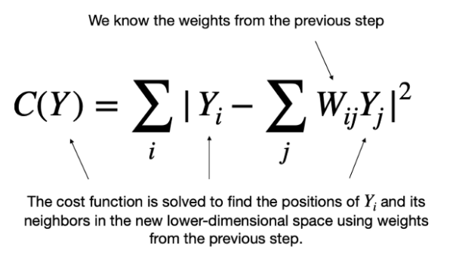
Locally Linear embedding

Slide 38
Implementation

